Slide 1
Chapter 1
Introduction and Data Collection
Basic Business Statistics
11th Edition
Basic Business Statistics, 11e © 2009 Prentice-Hall, Inc.
Chap 1-<number>

Slide 2
Learning Objectives
In this chapter you learn:
How Statistics is used in business
The sources of data used in business
The types of data used in business
The basics of Microsoft Excel
The basics of Minitab
Basic Business Statistics, 11e © 2009 Prentice-Hall, Inc..
Chap 1-<number>

Slide 3
Why Learn Statistics?
So you are able to make better sense of the ubiquitous use of numbers:
  Business memos
  Business research
  Technical reports
  Technical journals
  Newspaper articles
  Magazine articles
Basic Business Statistics, 11e © 2009 Prentice-Hall, Inc..
Chap 1-<number>

Slide 4
What is statistics?
A branch of mathematics taking and transforming numbers into useful information for decision makers
Methods for processing & analyzing numbers
Methods for helping reduce the uncertainty inherent in decision making
Basic Business Statistics, 11e © 2009 Prentice-Hall, Inc..
Chap 1-<number>

Slide 5
Why Study Statistics?
Decision Makers Use Statistics To:
Present and describe business data and information properly
Draw conclusions about large groups of individuals or items, using information collected from subsets of the individuals or items.
Make reliable forecasts about a business activity
Improve business processes
Basic Business Statistics, 11e © 2009 Prentice-Hall, Inc..
Chap 1-<number>

Slide 6
Types of Statistics
Statistics
The branch of mathematics that transforms data into useful information for decision makers.
Descriptive Statistics
Collecting, summarizing, and describing data
Inferential Statistics
Drawing conclusions and/or making decisions concerning a population based only on sample data
Basic Business Statistics, 11e © 2009 Prentice-Hall, Inc..
Chap 1-<number>

Slide 7

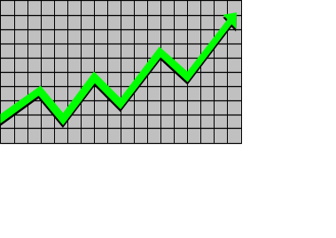
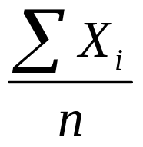
Descriptive Statistics
Collect data
  e.g., Survey
Present data
  e.g., Tables and graphs
Characterize data
  e.g., Sample mean =
Basic Business Statistics, 11e © 2009 Prentice-Hall, Inc..
Chap 1-<number>

Slide 8
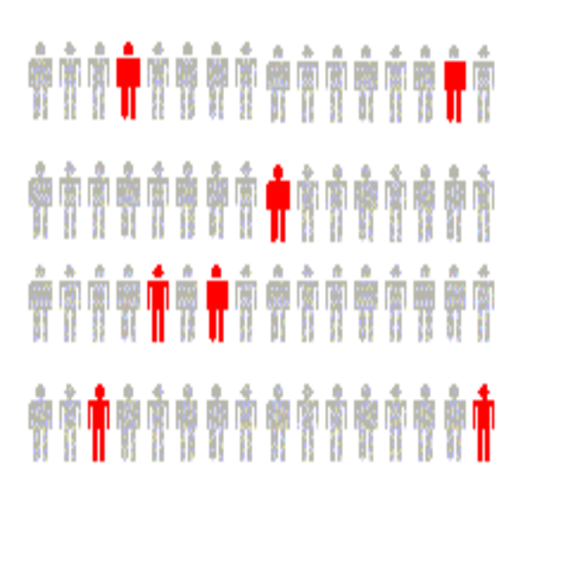
Inferential Statistics
Estimation
  e.g., Estimate the population mean weight using the sample mean weight
Hypothesis testing
  e.g., Test the claim that the population mean weight is 120 pounds
Drawing conclusions about a large group of individuals based on a subset of the large group.
Basic Business Statistics, 11e © 2009 Prentice-Hall, Inc..
Chap 1-<number>

Slide 9
Basic Vocabulary of Statistics
VARIABLE A variable is a characteristic of an item or individual. DATA Data are the different values associated with a variable. OPERATIONAL DEFINITIONS Data values are meaningless unless their variables have operational definitions, universally accepted meanings that are clear to all associated with an analysis.
Basic Business Statistics, 11e © 2009 Prentice-Hall, Inc..
Chap 1-<number>

Slide 10
Basic Vocabulary of Statistics
POPULATION A population consists of all the items or individuals about which you want to draw a conclusion. SAMPLE A sample is the portion of a population selected for analysis. PARAMETER A parameter is a numerical measure that describes a characteristic of a population. STATISTIC A statistic is a numerical measure that describes a characteristic of a sample.
Basic Business Statistics, 11e © 2009 Prentice-Hall, Inc..
Chap 1-<number>

Slide 11
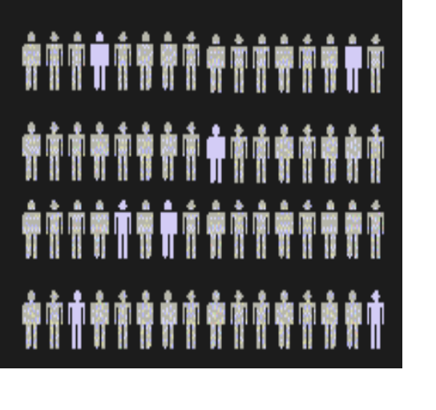
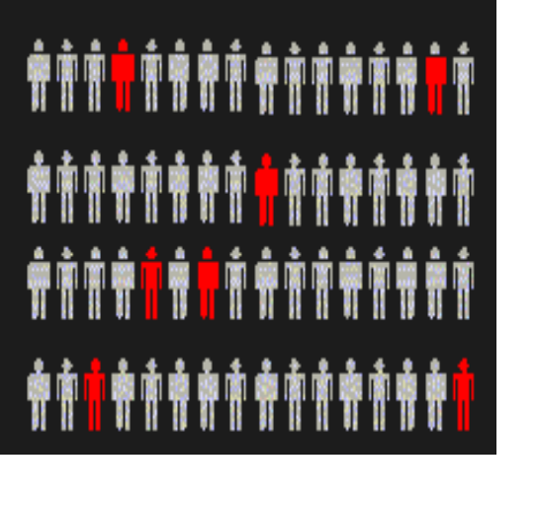
Population vs. Sample
Population
Sample
Measures used to describe the population are called parameters
Measures computed from sample data are called statistics
Basic Business Statistics, 11e © 2009 Prentice-Hall, Inc..
Chap 1-<number>

Slide 12
Why Collect Data?
A marketing research analyst needs to assess the effectiveness of a new television advertisement.
A pharmaceutical manufacturer needs to determine whether a new drug is more effective than those currently in use.
An operations manager wants to monitor a manufacturing process to find out whether the quality of the product being manufactured is conforming to company standards.
An auditor wants to review the financial transactions of a company in order to determine whether the company is in compliance with generally accepted accounting principles.
Basic Business Statistics, 11e © 2009 Prentice-Hall, Inc..
Chap 1-<number>

Slide 13
Sources of Data
Primary Sources: The data collector is the one using the data for analysis
  Data from a political survey
  Data collected from an experiment
  Observed data
Secondary Sources: The person performing data analysis is not the data collector
  Analyzing census data
  Examining data from print journals or data published on the internet.
Basic Business Statistics, 11e © 2009 Prentice-Hall, Inc..
Chap 1-<number>

Slide 14
Sources of data fall into four categories
Data distributed by an organization or an individual
A designed experiment
A survey
An observational study
Basic Business Statistics, 11e © 2009 Prentice-Hall, Inc..
Chap 1-<number>

Slide 15
Types of Variables
Categorical (qualitative) variables have values that can only be placed into categories, such as “yes” and “no.”
Numerical (quantitative) variables have values that represent quantities.
Basic Business Statistics, 11e © 2009 Prentice-Hall, Inc..
Chap 1-<number>

Slide 16
Types of Data
Data
Categorical
Numerical
Examples:
Marital Status
Political Party
Eye Color
(Defined categories)
Discrete
Continuous
Examples:
Number of Children
Defects per hour
(Counted items)
Examples:
Weight
Voltage
(Measured characteristics)
Basic Business Statistics, 11e © 2009 Prentice-Hall, Inc..
Chap 1-<number>

Slide 17
Levels of Measurement
A nominal scale classifies data into distinct categories in which no ranking is implied.
Categorical Variables Categories
Personal Computer Ownership
Type of Stocks Owned
Internet Provider
Yes / No
Growth Value Other
Microsoft Network / AOL/ Other
Basic Business Statistics, 11e © 2009 Prentice-Hall, Inc..
Chap 1-<number>

Slide 18

Levels of Measurement
An ordinal scale classifies data into distinct categories in which ranking is implied
Categorical Variable Ordered Categories
Student class designation | Freshman, Sophomore, Junior, Senior
Product satisfaction | Satisfied, Neutral, Unsatisfied
Faculty rank | Professor, Associate Professor, Assistant Professor, Instructor
Standard & Poor’s bond ratings | AAA, AA, A, BBB, BB, B, CCC, CC, C, DDD, DD, D
Student Grades | A, B, C, D, F
Basic Business Statistics, 11e © 2009 Prentice-Hall, Inc..
Chap 1-<number>

Slide 19
Levels of Measurement
An interval scale is an ordered scale in which the difference between measurements is a meaningful quantity but the measurements do not have a true zero point.
A ratio scale is an ordered scale in which the difference between the measurements is a meaningful quantity and the measurements have a true zero point.
Basic Business Statistics, 11e © 2009 Prentice-Hall, Inc..
Chap 1-<number>

Slide 20
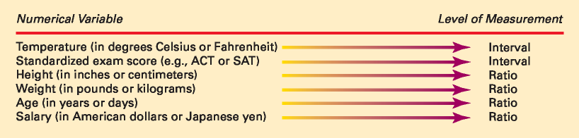
Interval and Ratio Scales
Basic Business Statistics, 11e © 2009 Prentice-Hall, Inc..
Chap 1-<number>

Slide 21
Personal Computer Programs Used For Statistics
Minitab
  A statistical package to perform statistical analysis
  Designed to perform analysis as accurately as possible
Microsoft Excel
  A multi-functional data analysis tool
  Can perform many functions but none as well as programs that are dedicated to a single function.
Both Minitab and Excel use worksheets to store data
Basic Business Statistics, 11e © 2009 Prentice-Hall, Inc..
Chap 1-<number>

Slide 22
Minitab & Microsoft Excel Terms
When you use Minitab or Microsoft Excel, you place the data you have collected in worksheets.
The intersections of the columns and rows of worksheets form boxes called cells.
If you want to refer to a group of cells that forms a contiguous rectangular area, you can use a cell range.
Worksheets exist inside a workbook in Excel and inside a Project in Minitab.
Both worksheets and projects can contain both data, summaries, and charts.
Basic Business Statistics, 11e © 2009 Prentice-Hall, Inc..
Chap 1-<number>

Slide 23
You are using programs properly if you can
Understand how to operate the program
Understand the underlying statistical concepts
Understand how to organize and present information
Know how to review results for errors
Make secure and clearly named backups of your work
Basic Business Statistics, 11e © 2009 Prentice-Hall, Inc..
Chap 1-<number>

Slide 24
Chapter Summary
In this chapter, we have
Reviewed why a manager needs to know statistics
Introduced key definitions:
  Population vs. Sample
  Primary vs. Secondary data types
  Categorical vs. Numerical data
Examined descriptive vs. inferential statistics
Reviewed data types and measurement levels
Discussed Minitab and Microsoft Excel terms
Basic Business Statistics, 11e © 2009 Prentice-Hall, Inc..
Chap 1-<number>

